Slide 1
CHAPTER 2
COMPRESSION

Slide 2



HOMEWORK
05 MIN
PRESENTATION OF RESEARCHES
how to convert an RGB color (8 bits per color) to hexadecimal?
1 student present it to the class, by giving examples

Slide 3


DISCUSS
05 MIN
Why might we use abbreviations when sending messages?
What are the advantages?
Good night
nop7 !
C u soon

Slide 4
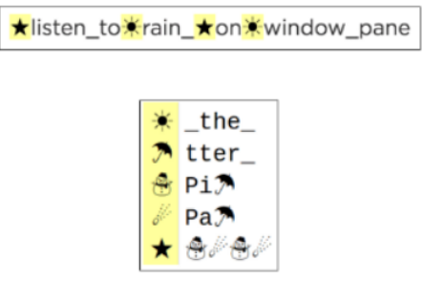
DISCUSS
05 MIN
I want to send this message to my friend
So I compress my message as follows:
But my phone can only send 80 characters
Pitter_patter_pitter_patter_listen_to_the_rain_pitter_patter_pitter_
patter_on_the_window_pane
Q1 : How can we get the blue message from the green one ?

Slide 5
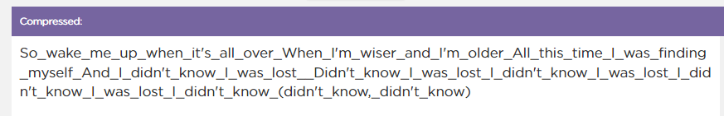
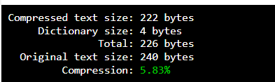
PRACTICE
Text editor - CHALLENGE 1
https://studio.code.org/s/csp1-2021/lessons/9/levels/1?no_redirect=1
15 MIN
INDIV
Look for patterns (repeated words or phrases) to put in the dictionary
Note your COMPRESSION RATE
Winner is : the one with highest rate

Slide 6
DISCUSS
05 MIN
What strategies are you using to compress your sample text?
Which ones seem most successful?

Slide 7

VIDEO
15 MIN
INDIV
Watch the video and take notes
https://studio.code.org/s/csp1-2021/lessons/9/levels/2?no_redirect=1
Explain what is the difference between LOSSLESS and LOSSY compression ?
The previous compression method was : LOSSLESS or LOSSY ?
Try again the previous challenge and try to increase your COMPRESSION RATE !!!!
Notes:
When solving computational problems, it can sometimes be helpful to restart completely from the beginning. This activity may be a good place to suggest this to students, especially those that feel particularly stuck or frustrated - sometimes restarting from the very beginning surfaces new ideas and strategies that we didn’t see before.

Slide 8
EXPLAIN
05 MIN
LOSS-LESS COMPRESSION
A process for reducing the number of bits needed to represent something without losing any information. This process is reversible.
01101100 01101111 01110011 01110011 01101100 01100101 01110011 01110011
COMPRESS
1111111101101100 0111 111011
UNCOMPRESS

Slide 9
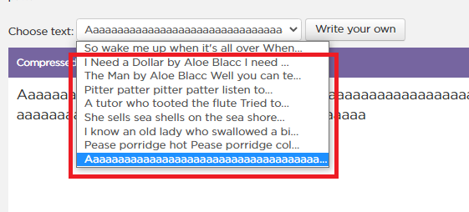
PRACTICE
Text editor - CHALLENGE 2
https://studio.code.org/s/csp1-2021/lessons/9/levels/1?no_redirect=1
15 MIN
GROUP 2
IN teams now try to compress 2 other text examples
Why some text are easier to compress than other ? Give 1 reason at least

Slide 10
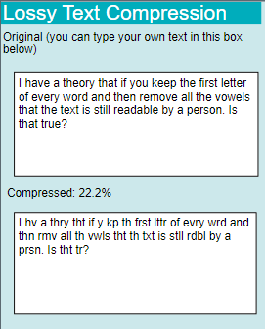
PRACTICE
Try this Lossy compression:
10 MIN
TEAM 2
https://studio.code.org/projects/applab/hxXJIEGg2yza_Q7t9W04xg
How does this compression works?
What will be the compressed word
for “ronan” ?
for“understand”?
Why can we say it’s a lossy compression ?

Slide 11
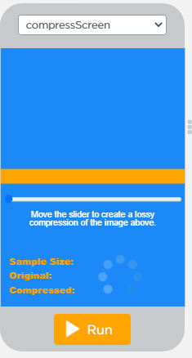
PRACTICE
Lossy compression with image
10 MIN
TEAM 2
https://studio.code.org/s/csp1-2021/lessons/10/levels/1?no_redirect=1
Run the program and move the slider
What do you notice about the quality of the image when you compress it?
What do you notice about the compressed file size?
Why can we say it’s a lossy compression ?

Slide 12
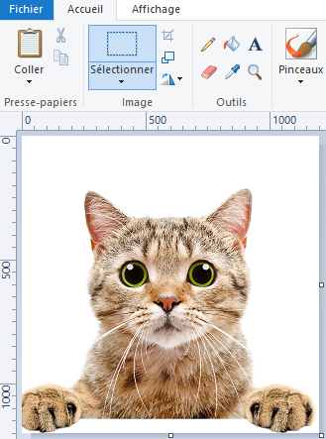
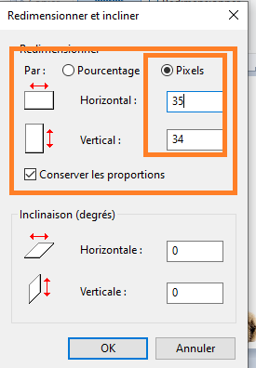
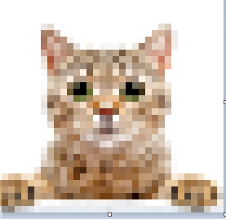
PRACTICE
Lossy compression with image
10 MIN
INDIV
Run paint application and open an image
Click on resize and select 35 pixel width and height
Now try to resize to the original size
Can you get back the original image ?

Slide 13
EXPLAIN
05 MIN
LOSSY COMPRESSION
A process for reducing the number of bits needed to represent something in which some information is lost or thrown away. This process is not reversible.
01101100 01101111 01110011 01110011 01101100 01100101 01110011 01110011
COMPRESS
1111111101101100 0111 111011
UNCOMPRESS

